Slide 1

Longitudinal dynamic in NICA Barrier Bucket RF System
at transition energy, including impedances in BLonD. Продольная динамики в ВЧ типа Barrier Bucket
при критической энергии с учётом импедансов в BLonD.
Докладчик: Колокольчиков С. ¹ (kolokolchikov@inr.ru)
Со-авторы: Сеничев Ю.¹, Аксентьев А. ¹, Мельников А. ¹,
Ладыгин В. ², Сыресин Е. ²
¹Институт Ядерных Исследований РАН, Москва, Россия
²Объединенный Институт Ядерных Исследований, Дубна, Россия.
Москва, 10 июля 2023 г.
10/07/2023
1
Москва, 2023 г.

Slide 2
TABLE OF CONTENTS
Longitudinal Dynamic
Transition Energy
Barrier Bucket
Impedances
BLonD
10/07/2023
2
Москва, 2023 г.

Slide 3
Abstract
В работе исследуется влияние импедансов пространственного заряда, а также ВЧ резонаторов на продольную динамику во время процедуры прохождения критической энергии скачком. Отличительной особенностью является применение ВЧ барьерного типа, результатом его использования является специфическое распределение пучка в фазовом пространстве, отличное от классического, образованного гармоническим ВЧ.
The paper investigates the influence of space charge impedances, as well as RF resonators, on longitudinal dynamics during the procedure of transition energy crossing with a jump. A distinctive feature is the use of Barrier Bucket RF, as a result a specific distribution of the beam in the phase space, different from the classical one formed by harmonic RF.
10/07/2023
3
Москва, 2023 г.

Slide 4
Longitudinal Dynamic
10/07/2023
4
Москва, 2023 г.

Slide 5
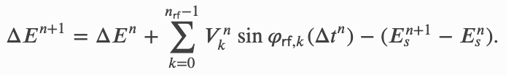
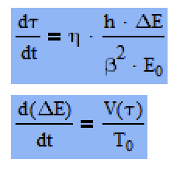
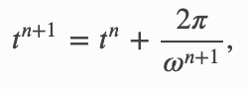
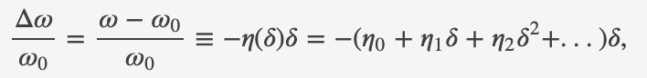
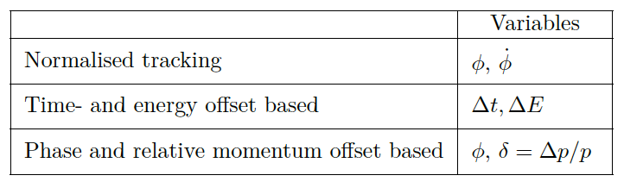
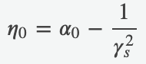
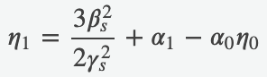
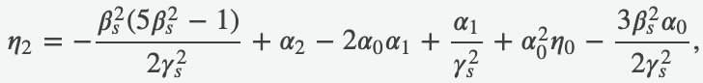
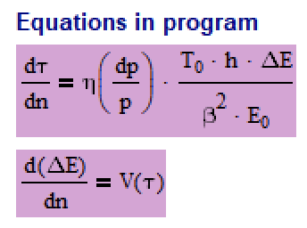
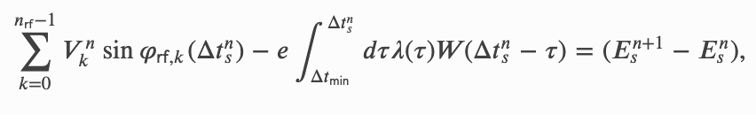
Equations of Longitudinal Motion
Classical form
– Energy Kick
– arrival Time drift
Slippage factor
Synchronious Particle
BLonD: https://blond.web.cern.ch/
10/07/2023
5
Москва, 2023 г.

Slide 6
Transition Energy
10/07/2023
6
Москва, 2023 г.

Slide 7
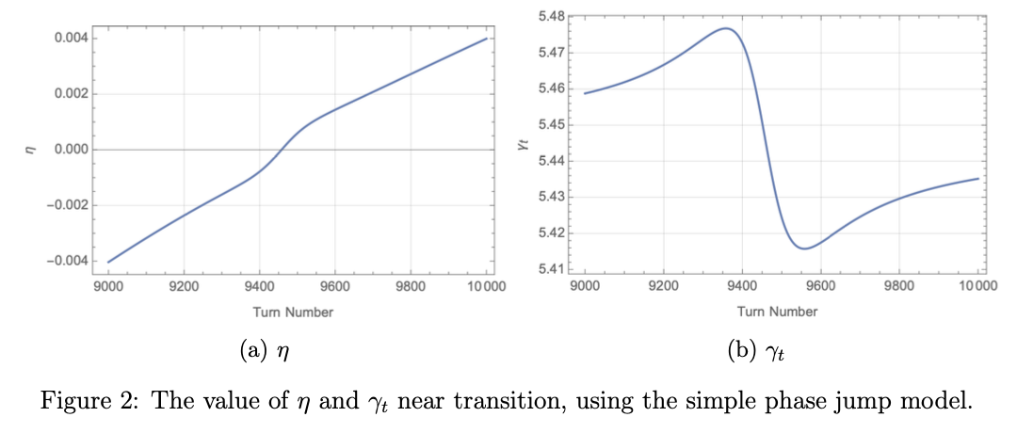
Transition
P. F. Derwent, Implementation of BLonD for Booster Simulations, Beams-doc # 8690, 2020
10/07/2023
7
Москва, 2023 г.

Slide 8
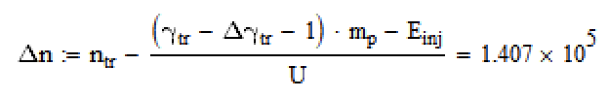
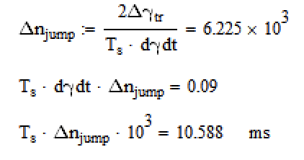
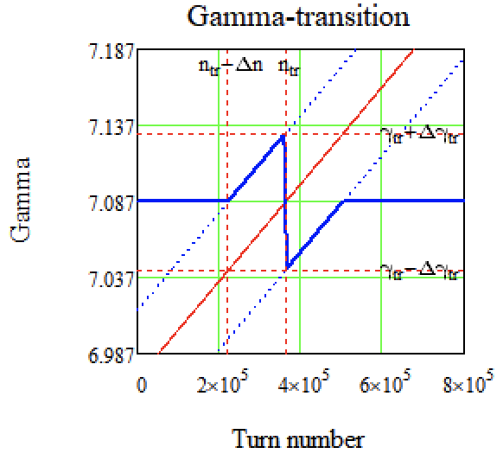
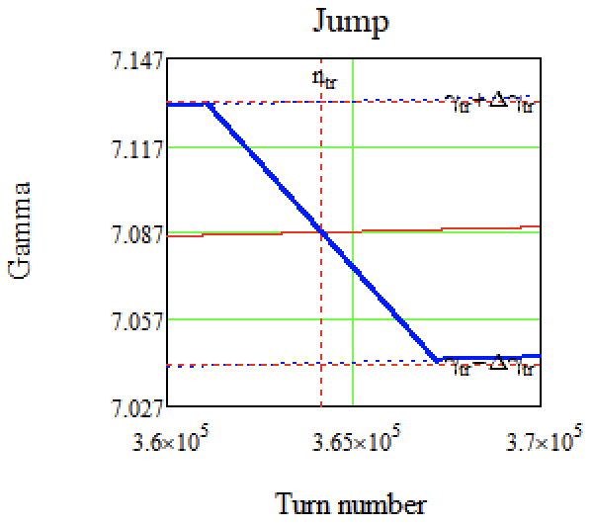
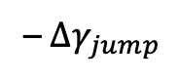
Jump-scheme at NICA
– turns before jump
– turns at jump
– $∆γ_{jump}$
Here is a 5 different states of longitudinal
optics based on transition energy:
1) acceleration from injection energy with initial value;
2) smooth increase to peak;
3) jump;
4) smooth recovery till initial transition;
5) initial value till the experiment energy;
First defines 3) state based on the maximum available speed of transition shift and available transition size
Secondly, we can understand states 3 and 4, as they changed parallel to beam energy
Finally, states 3 and 5 also can be understand
– jump time
2
2
1
3
5
3
4
4
10/07/2023
8
Москва, 2023 г.

Slide 9
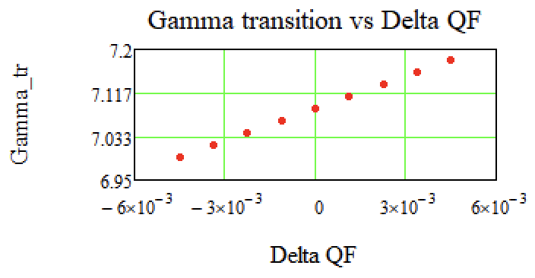
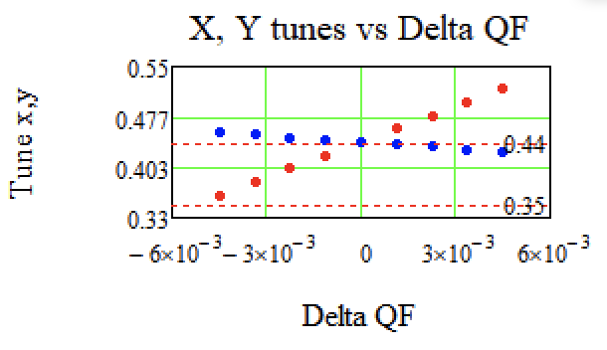
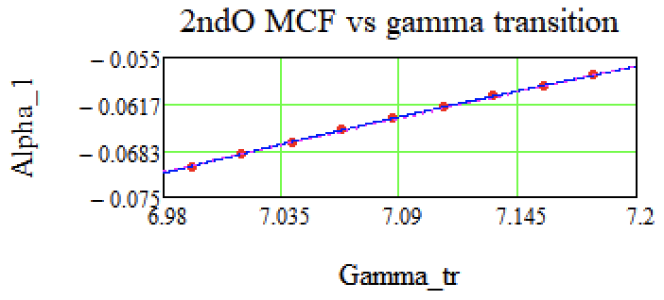
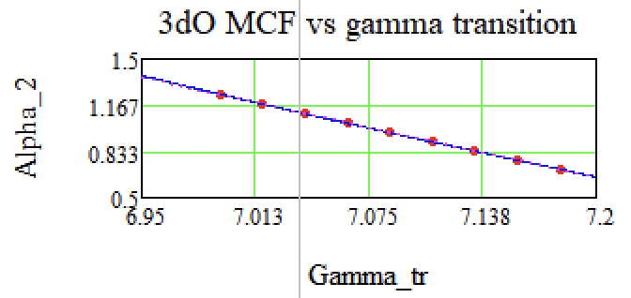
Momentum compaction factor at Transition
10/07/2023
9
Москва, 2023 г.

Slide 10
Barrier Bucket
10/07/2023
10
Москва, 2023 г.

Slide 11
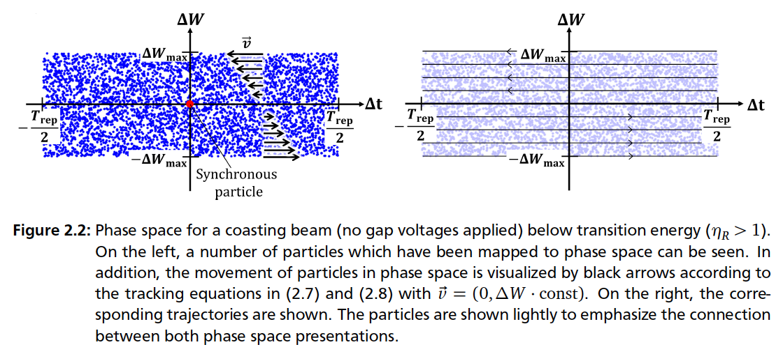
Coasting Beam
Jens Schweickhardt, Modeling and Optimization of Barrier-Bucket RF Systems, 2021
10/07/2023
11
Москва, 2023 г.

Slide 12
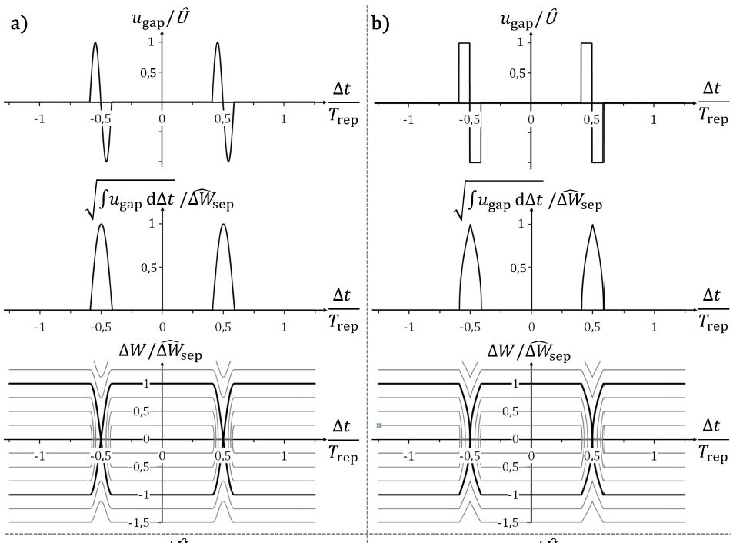
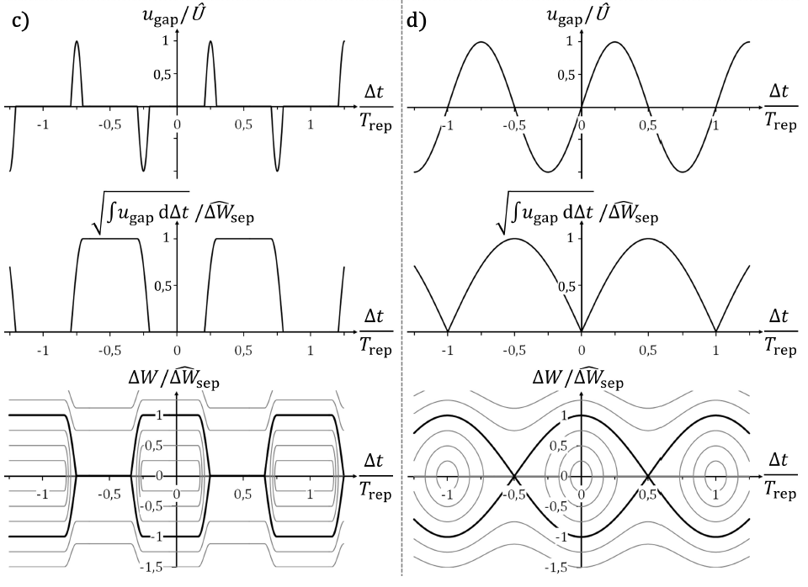
Phase portraits of different BB
Jens Schweickhardt, Modeling and Optimization of Barrier-Bucket RF Systems, 2021
10/07/2023
12
Москва, 2023 г.

Slide 13
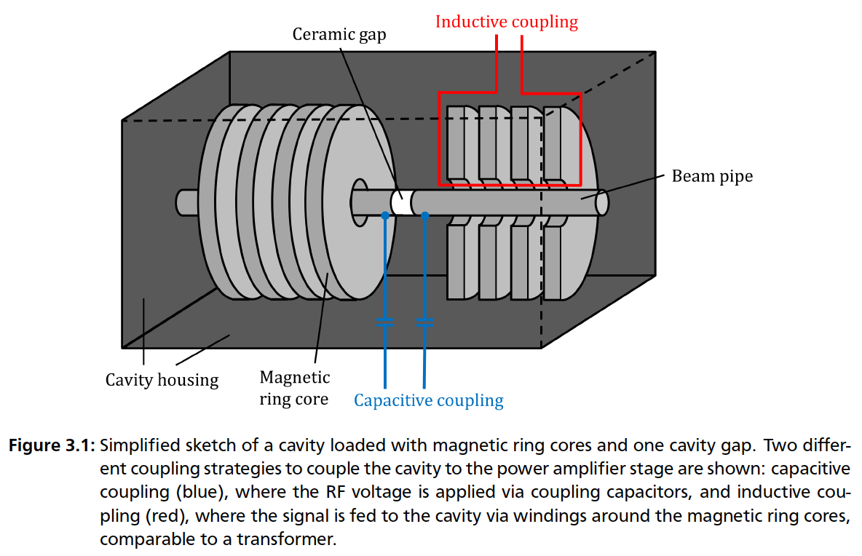
Barrier Bucket
Jens Schweickhardt, Modeling and Optimization of Barrier-Bucket RF Systems, 2021
10/07/2023
13
Москва, 2023 г.

Slide 14
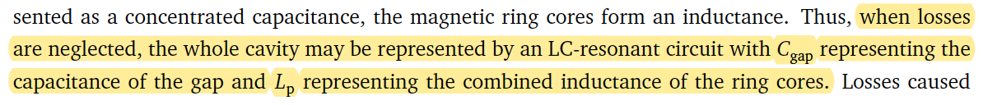
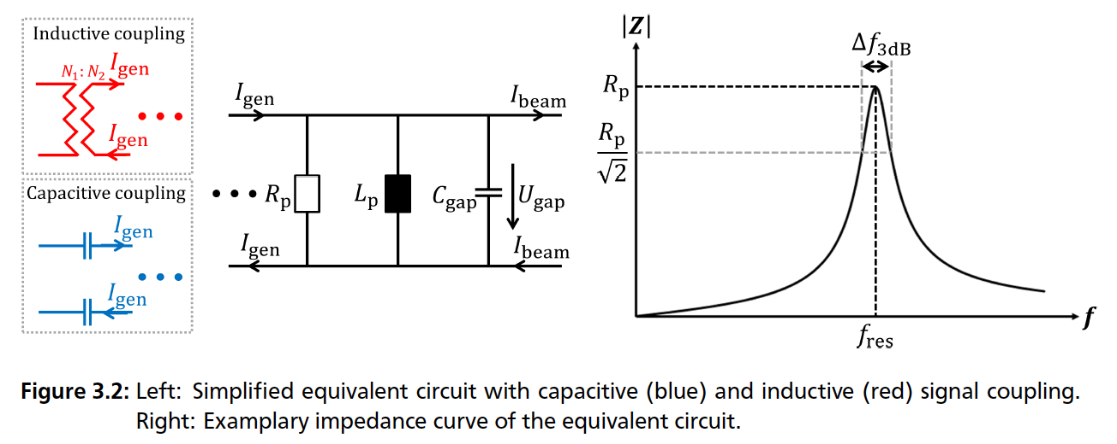
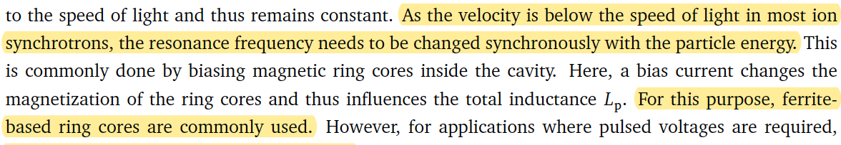
Ferrite-loaded cavity
Jens Schweickhardt, Modeling and Optimization of Barrier-Bucket RF Systems, 2021
10/07/2023
14
Москва, 2023 г.

Slide 15
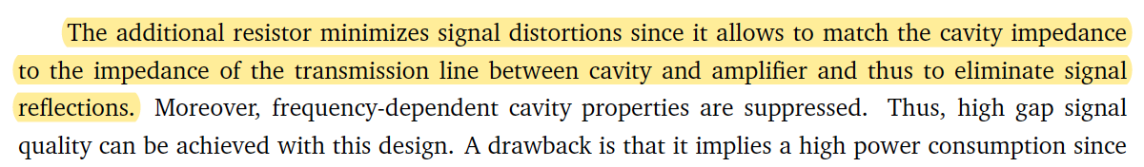
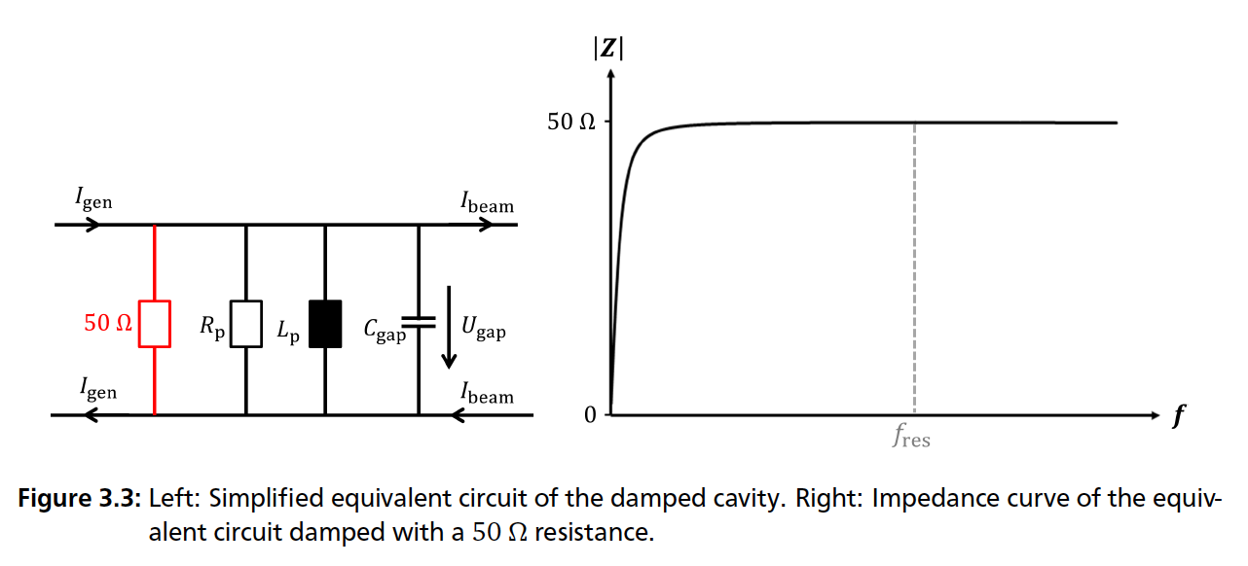
Ferrite-loaded cavity
Ferrite-loaded cavity:
Fermilab Antiproton Debuncher
Fermilab Recycler Ring
GSI Experimental Storage Ring
Jens Schweickhardt, Modeling and Optimization of Barrier-Bucket RF Systems, 2021
10/07/2023
15
Москва, 2023 г.

Slide 16
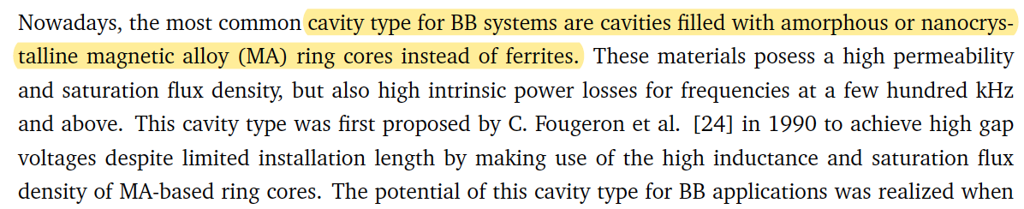
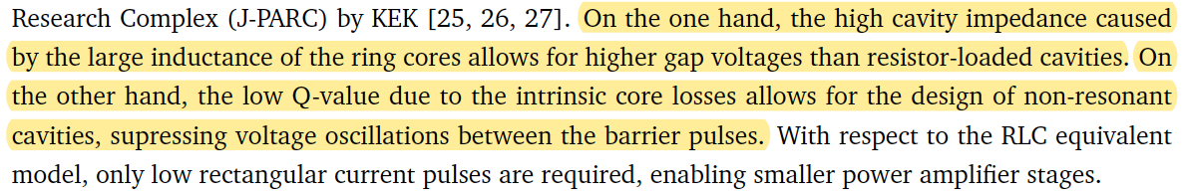
MA-loaded cavities
What is it
MA-loaded cavities:
Fermilab Main Injector
BNL Alternating Gradient Synchrotron (AGS),
KEK Digital Accelerator (DA)
KEK Proton Synchrotron (PS)
Facility for Antiproton and Ion Research (FAIR)
High Energy Storage Ring (HESR)
Schwerionensynchrotron
(SIS100)
Experimental Storage Ring (ESR)
COSY
Difference
Jens Schweickhardt, Modeling and Optimization of Barrier-Bucket RF Systems, 2021
10/07/2023
16
Москва, 2023 г.

Slide 17
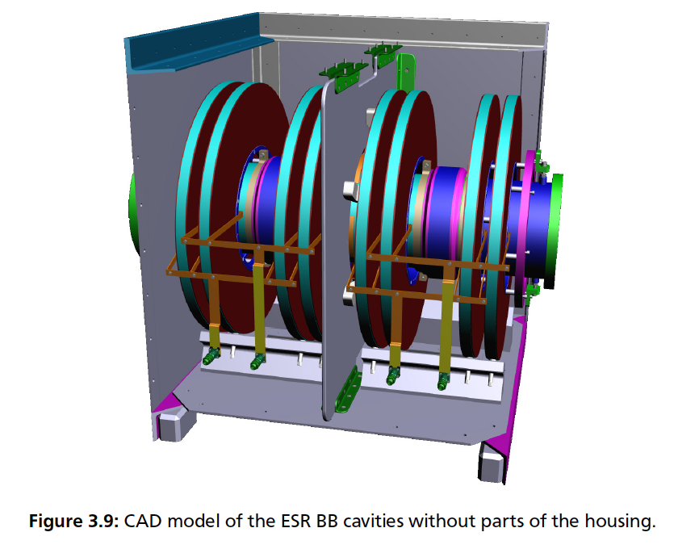
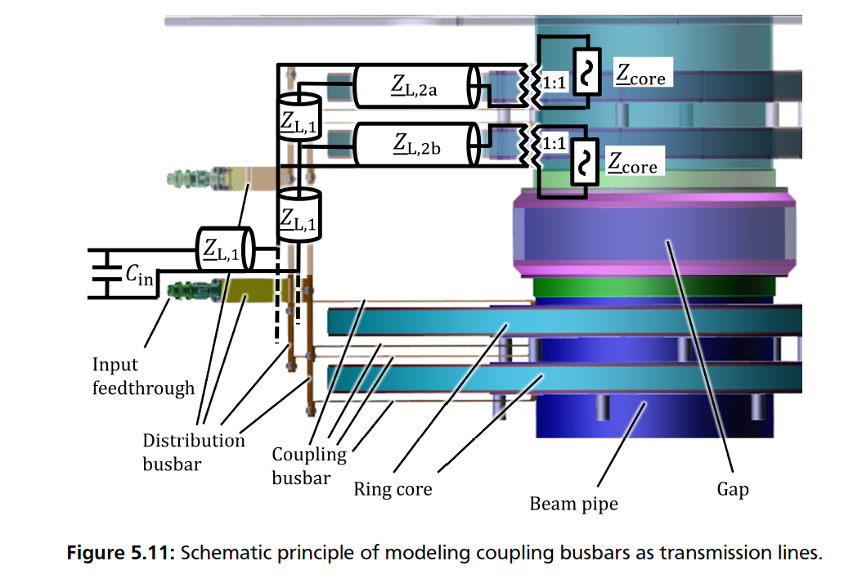
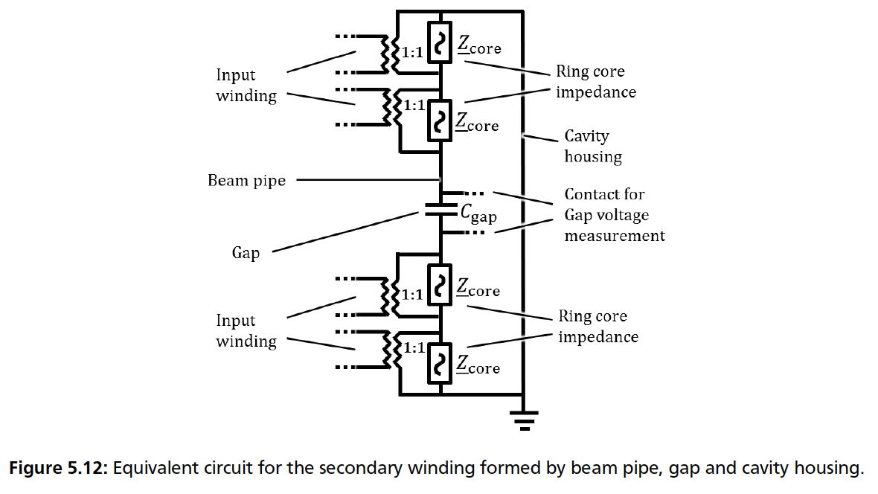
The ESR BB system
Jens Schweickhardt, Modeling and Optimization of Barrier-Bucket RF Systems, 2021
10/07/2023
17
Москва, 2023 г.

Slide 18
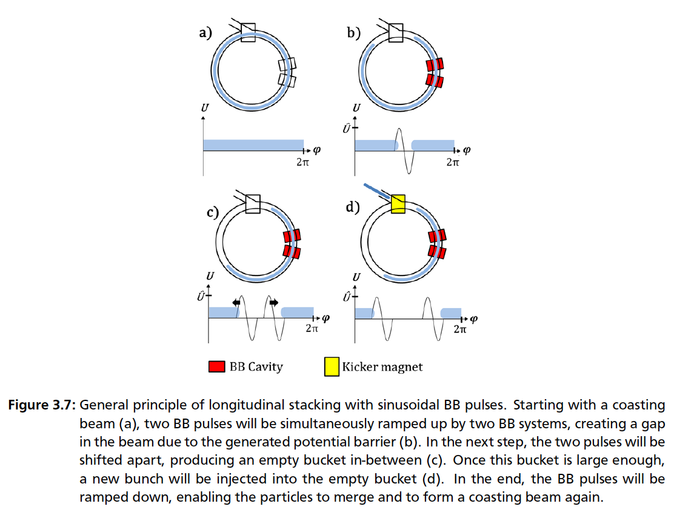
Principle of stacking with BB
Jens Schweickhardt, Modeling and Optimization of Barrier-Bucket RF Systems, 2021
10/07/2023
18
Москва, 2023 г.

Slide 19
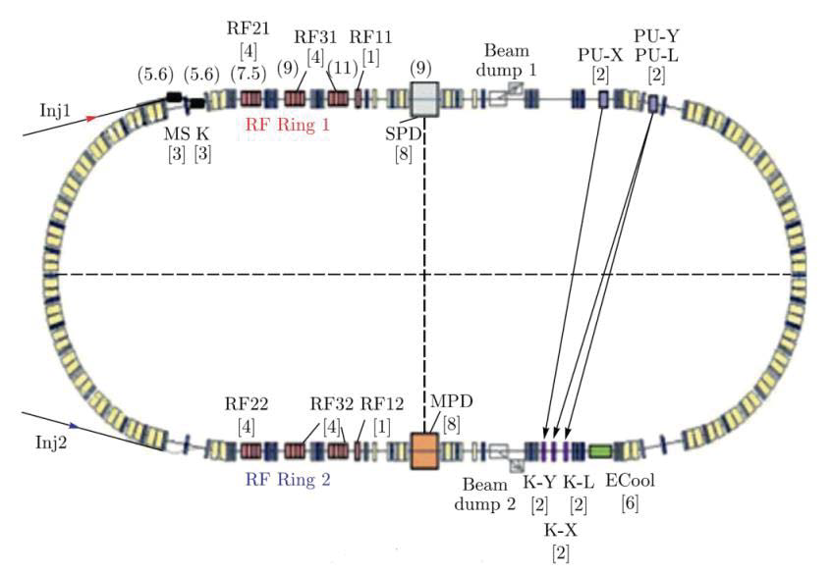
NICA Elements
10/07/2023
19
Москва, 2023 г.

Slide 20
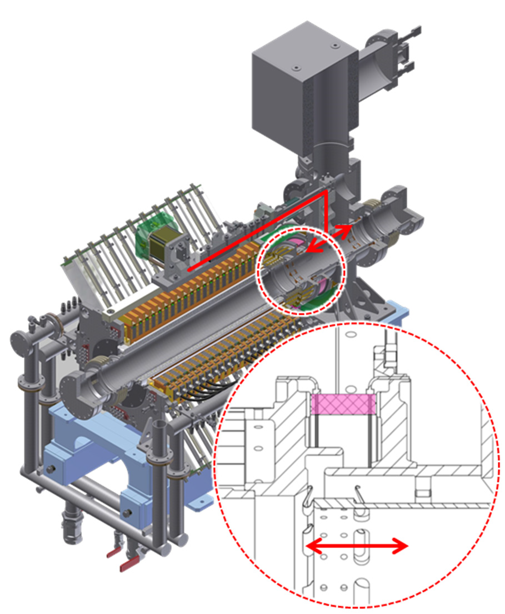
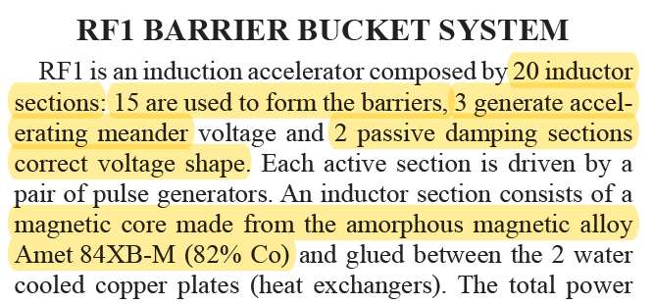
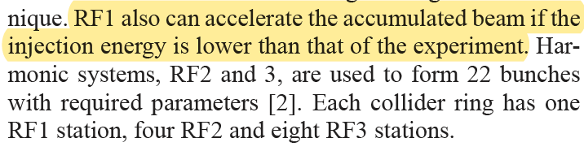
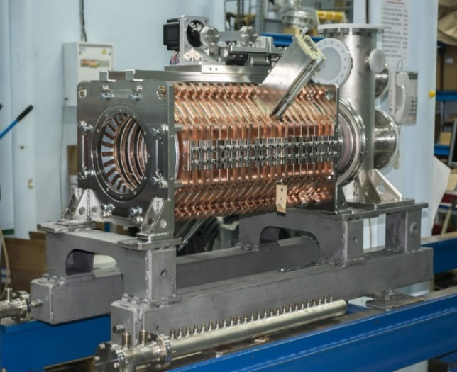
Barrier Bucket at NICA
A. Tribendis and others, Constraction and first test results of the barrier and harmonic RF systems for the NICA collider, IPAC2021, Campinas, SP, Brazil, doi:10.18429/JACoW-IPAC2021-MOPAB365
10/07/2023
20
Москва, 2023 г.

Slide 21
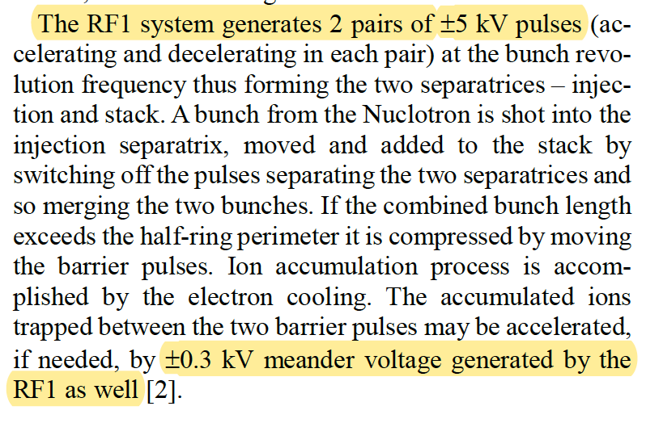
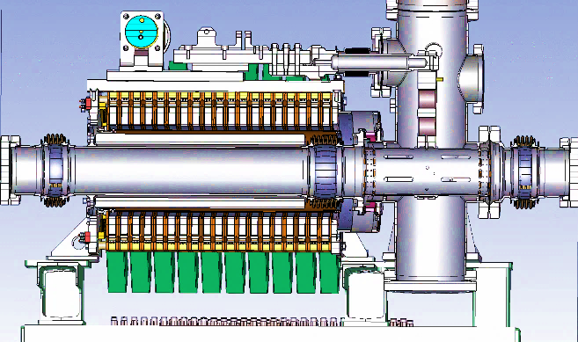
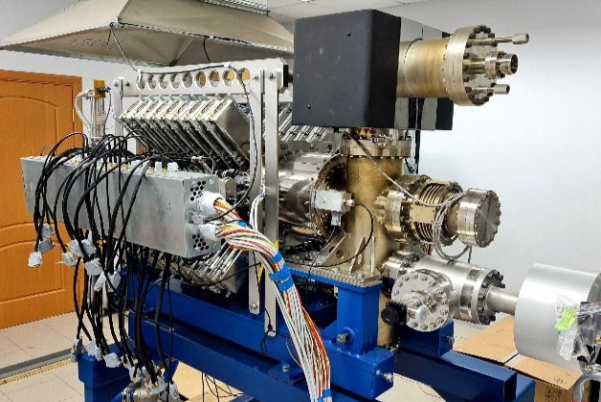
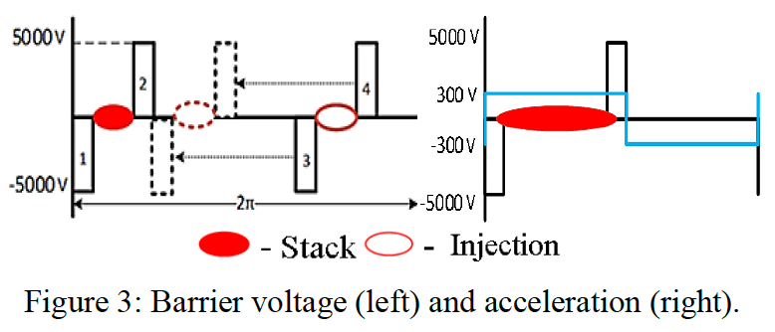
Barrier Bucket at NICA
A.M. Malyshev and others, Barrier station RF1 of the NICA collider. Design features and influence on beam dynamics, RuPAC2021, Alushta, Russia, doi:10.18429/JACoW-RuPAC2021-WEPSC15
10/07/2023
21
Москва, 2023 г.

Slide 22
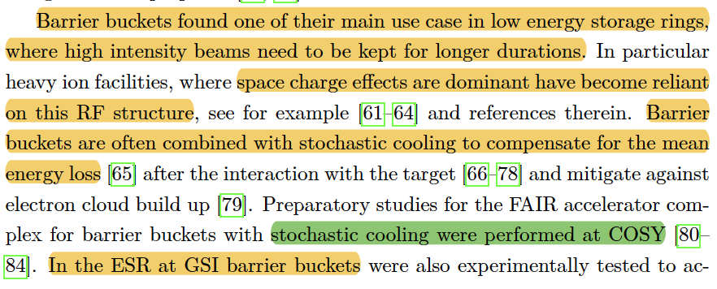
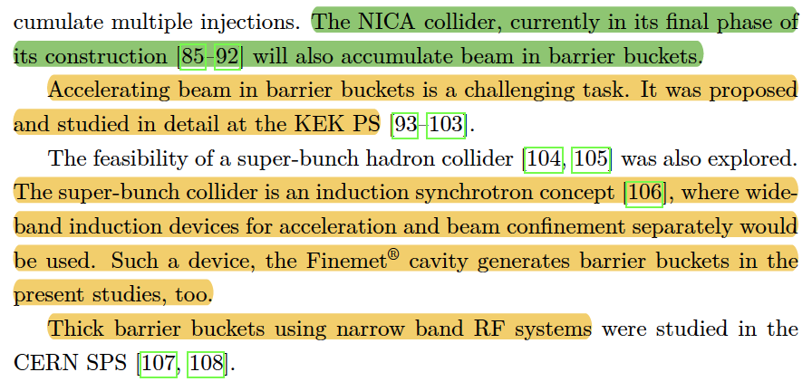
Barrier Bucket Summarize
10/07/2023
22
Москва, 2023 г.

Slide 23
Impedance
10/07/2023
23
Москва, 2023 г.

Slide 24
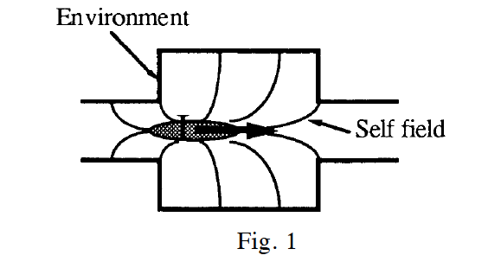
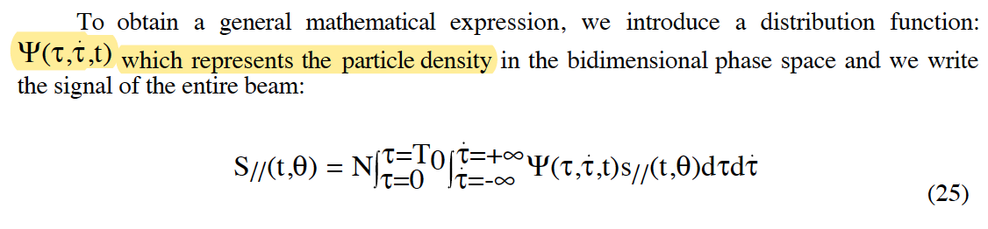
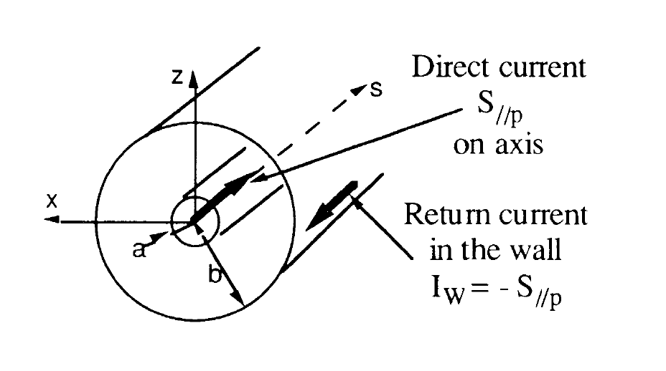
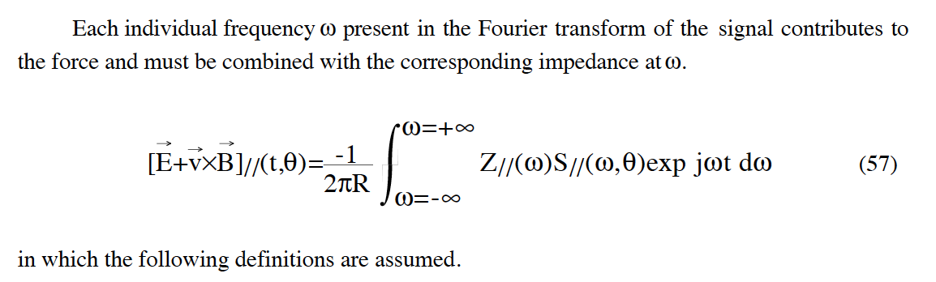
Impedances
Definition of Impedance:
Laclare, J L (ESRF, Grenoble), Coasting beam longitudinal coherent instabilities, CAS - CERN Accelerator School : 5th General Accelerator Physics Course, pp.349-384, DOI: 10.5170/CERN-1994-001.349
10/07/2023
24
Москва, 2023 г.

Slide 25




Space Charge Impedance
10/07/2023
25
Москва, 2023 г.

Slide 26


Dispersion Relation
Laclare, J L (ESRF, Grenoble), Coasting beam longitudinal coherent instabilities, CAS - CERN Accelerator School : 5th General Accelerator Physics Course, pp.349-384, DOI: 10.5170/CERN-1994-001.349
10/07/2023
26
Москва, 2023 г.

Slide 27


Vlasov’s Equation and Dispersion Relation
Laclare, J L (ESRF, Grenoble), Coasting beam longitudinal coherent instabilities, CAS - CERN Accelerator School : 5th General Accelerator Physics Course, pp.349-384, DOI: 10.5170/CERN-1994-001.349
10/07/2023
27
Москва, 2023 г.

Slide 28





Impedances NICA
П.Р. Зенкевич, А.А. Коломиец
Электромагнитное моделирование
элементов структуры коллайдера NICA
Письма в ЭЧАЯ. 2020. Т. 17, № 4(229). С. 445–452
10/07/2023
28
Москва, 2023 г.

Slide 29




NON-RF Impedances NICA
П.Р. Зенкевич, А.А. Коломиец
Электромагнитное моделирование
элементов структуры коллайдера NICA
Письма в ЭЧАЯ. 2020. Т. 17, № 4(229). С. 445–452
10/07/2023
29
Москва, 2023 г.

Slide 30




RF Impedances NICA
П.Р. Зенкевич, А.А. Коломиец
Электромагнитное моделирование
элементов структуры коллайдера NICA
Письма в ЭЧАЯ. 2020. Т. 17, № 4(229). С. 445–452
10/07/2023
30
Москва, 2023 г.

Slide 31



BB RF1 Impedances
Equivalent circuit of one ring (from the 1st to the 19th).
Last ring and accelerating gap.
A.M. Malyshev and others, Barrier station RF1 of the NICA collider. Design features and influence on beam dynamics, RuPAC2021, Alushta, Russia, doi:10.18429/JACoW-RuPAC2021-WEPSC15
System impedance calculated by equivalent circuit impedance
10/07/2023
31
Москва, 2023 г.

Slide 32

BB RF1 Impedances
A.M. Malyshev and others, Barrier station RF1 of the NICA collider. Design features and influence on beam dynamics, RuPAC2021, Alushta, Russia, doi:10.18429/JACoW-RuPAC2021-WEPSC15
System impedance calculated by equivalent circuit impedance
10/07/2023
32
Москва, 2023 г.

Slide 33
BLonD Beam Longitudinal Dynamic
BLonD: https://blond.web.cern.ch/
10/07/2023
33
Москва, 2023 г.

Slide 34


BLonD. Scheme
BLonD Classes:
Ring
Beam
Distribution
Profile
RF Station
Impedance source
Induce voltage
Tracker
Plot
P. F. Derwent, Implementation of BLonD for Booster Simulations, Beams-doc # 8690, 2020
10/07/2023
34
Москва, 2023 г.

Slide 35


BLonD. Ring
BLonD: https://blond.web.cern.ch/
10/07/2023
35
Москва, 2023 г.

Slide 36


BLonD. Beam & Distribution
BLonD: https://blond.web.cern.ch/
10/07/2023
36
Москва, 2023 г.

Slide 37


BLonD. RF Station
BLonD: https://blond.web.cern.ch/
10/07/2023
37
Москва, 2023 г.

Slide 38

BLonD. Profile
BLonD: https://blond.web.cern.ch/
10/07/2023
38
Москва, 2023 г.

Slide 39




BLonD. Tracker
BLonD: https://blond.web.cern.ch/
10/07/2023
39
Москва, 2023 г.

Slide 40



BLonD. Resonators
Low frequency
Example: RF1
High frequency
BLonD: https://blond.web.cern.ch/
10/07/2023
40
Москва, 2023 г.

Slide 41


BLonD. Inductive Impedance (SC) – Induced Voltage
BLonD: https://blond.web.cern.ch/
10/07/2023
41
Москва, 2023 г.

Slide 42

BLonD. Users Impedance
BLonD: https://blond.web.cern.ch/
10/07/2023
42
Москва, 2023 г.

Slide 43








Fourier Expansion
Square signal
Fourier Expansion
Sigma modulation
RF Kick
Mihaly Vadai, Beam Loss Reduction by Barrier Buckets
in the CERN Accelerator Complex, CERN, Geneva, 2021
10/07/2023
43
Москва, 2023 г.

Slide 44




10/07/2023
44
Москва, 2023 г.

Slide 45

Separatrix of BB
Jens Schweickhardt, Modeling and Optimization of Barrier-Bucket RF Systems, 2021
10/07/2023
45
Москва, 2023 г.

Slide 46


RF1 vs SC
BLonD: https://blond.web.cern.ch/
10/07/2023
46
Москва, 2023 г.

Slide 47






Effect of High Order MCF
$γ_{tr}$ – smooth increase (2nd stage)
NO SC
BB RF
$α_{0,1,2}$ stationary
At 2nd stage
$$γ_{tr}∥γ_{beam}⇒ η_{s}∥η_{tr}$$
$$η_{s}=const$$
Taking into account $δ={dp}/p,$
get a range of $η$ for different particles
2
10/07/2023
47
Москва, 2023 г.

Slide 48





Space Charge & RF1 Resonant Impedance Effect at Transition Jump
Jump – (3^{d} stage)
Only SC
No RF
$α_{0,1,2}$ change at a turn
10/07/2023
48
Москва, 2023 г.

Slide 49
What’s Next
DONE
BLonD Modeling
High Order MCF
Resonant Impedance RF1
Space Charge Impedance
TO DO
Distribution match between 2-3 stages
Modeling 3-4 stages
Transition crossing with Harmonic RF (RF2?)
Another Impedance?
10/07/2023
49
Москва, 2023 г.

Slide 50
References
Laclare, J L (ESRF, Grenoble), Coasting beam longitudinal coherent instabilities, CAS - CERN Accelerator School : 5th General Accelerator Physics Course, pp.349-384, DOI: 10.5170/CERN-1994-001.349
Jens Schweickhardt, Modeling and Optimization of Barrier-Bucket RF Systems, 2021
Mihaly Vadai, Beam Loss Reduction by Barrier Buckets in the CERN Accelerator Complex, CERN, Geneva, 2021
П.Р. Зенкевич, А.А. Коломиец, Электромагнитное моделирование элементов структуры коллайдера NICA, Письма в ЭЧАЯ. 2020. Т. 17, № 4(229). С. 445–452
A. Tribendis and others, Constraction and first test results of the barrier and harmonic RF systems for the NICA collider, IPAC2021, Campinas, SP, Brazil, doi:10.18429/JACoW-IPAC2021-MOPAB365
A.M. Malyshev and others, Barrier station RF1 of the NICA collider. Design features and influence on beam dynamics, RuPAC2021, Alushta, Russia, doi:10.18429/JACoW-RuPAC2021-WEPSC15
P. F. Derwent, Implementation of BLonD for Booster Simulations, Beams-doc # 8690, 2020
BLonD: https://blond.web.cern.ch/
10/07/2023
50
Москва, 2023 г.

